Slide 1

Configuration-as-Code for Microsoft365
Village of Excellence – September 4th, 2020
@NikCharlebois

Slide 2

Nik Charlebois
Senior Customer Engineer – Global Technical Team
Based in Gatineau, Quebec
Ex-PowerShell MVP
Author of various PowerShell/O365 related books
Blogger at https://NikCharlebois.com
Owner and Creator of ReverseDSC, Microsoft365DSC and DSCParser
@NikCharlebois

Slide 3
What is Microsoft365DSC?
@NikCharlebois

Slide 4


Automate
Report
Export
Monitor
Synchronize
Assess
@NikCharlebois

Slide 5

Community
100% Open-Source on GitHub;
Lead by Microsoft Engineers / Maintained by the community;
Active external community & MVPs contributing;
aka.ms/M365DSC

Slide 6
Automate
@NikCharlebois

Slide 7
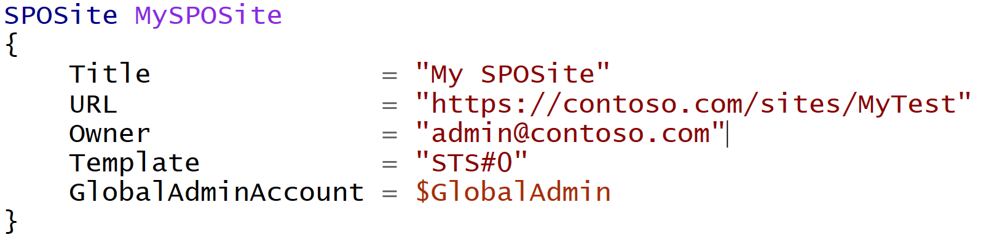
Difference with Classic PowerShell
It’s a Declarative approach;
@NikCharlebois
Notes:
Meaning I don’t tell it do this and then that, but rather here is how I want this, then do whatever in you need to to get me there

Slide 8
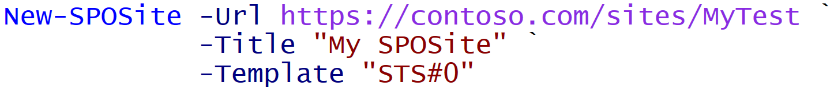
Difference with Classic PowerShell
Declarative:
Imperative:
@NikCharlebois
Notes:
Meaning I don’t tell it do this and then that, but rather here is how I want this, then do whatever you need to get me there

Slide 9

Automate – Deploy Configuration
Write your Microsoft 365 Configuration as Code
@NikCharlebois

Slide 10








Automate – Deploy Configuration
Automate the Configuration of all M365 Workloads
@NikCharlebois

Slide 11










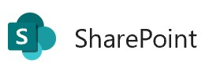

Current:
Planned:

Slide 12

Logic Flow
Abstraction layer sitting on top of all underlying modules;
Allows you to write 1 configuration to handle all workloads;
Microsoft365DSC Configuration
SharePoint PnP
MicrosoftTeams
SkypeForBusinessAPI
Exchange Online Shell
…
Remote Calls
Security & Compliance
@NikCharlebois

Slide 13
Demo 1
Automate
@NikCharlebois

Slide 14
Monitor
@NikCharlebois

Slide 15


Monitor – Continuously check for config drifts
Analyze for Drift
Act on detected drifts: Fix, Log or Alert
@NikCharlebois

Slide 16
Monitor Configuration Drifts
+Fix
+Monitor
Default Setting
ApplyOnly
ApplyAndMonitor
ApplyAndAutocorrect
Configure as specified, the done
Configure, and Log Configuration Drifts
Configure, Log & Fix Configuration Drifts
@NikCharlebois

Slide 17
Demo 2
Monitor
@NikCharlebois

Slide 18
Export
@NikCharlebois

Slide 19
Export – Get full fidelity config from existing tenant
Export
Full-Fidelity Configuration Export
Existing Microsoft 365 Environments
@NikCharlebois

Slide 20

Exposes the Export-M365DSCConfiguration cmdlet when M365DSC is installed;
Provides an interface to pick and choose components to extract;
Exports all configuration as a .ps1 configuration file;
Simply need to provide credentials of account with admin access to the selected workloads
@NikCharlebois

Slide 21
Demo 3
Export
@NikCharlebois

Slide 22
Report
@NikCharlebois

Slide 23


Report – Convert config to Excel or HTML
Export
Generate Reports
@NikCharlebois

Slide 24
Demo 4
Report
@NikCharlebois

Slide 25
Synchronize
@NikCharlebois

Slide 26
Synchronize – Keep multiple tenants’ config in Sync
Tenant A
Export
Automate
Tenant B
@NikCharlebois

Slide 27
Synchronize – Keep multiple tenants’ config in Sync
Tenant A
Tenant B
@NikCharlebois

Slide 28
Demo 5
Synchronize
@NikCharlebois

Slide 29
Assess
@NikCharlebois

Slide 30

Assess – Blueprints
Assess Existing Environments Against Known Good Configurations
M365DSC Blueprints
Discrepancy Report
@NikCharlebois

Slide 31
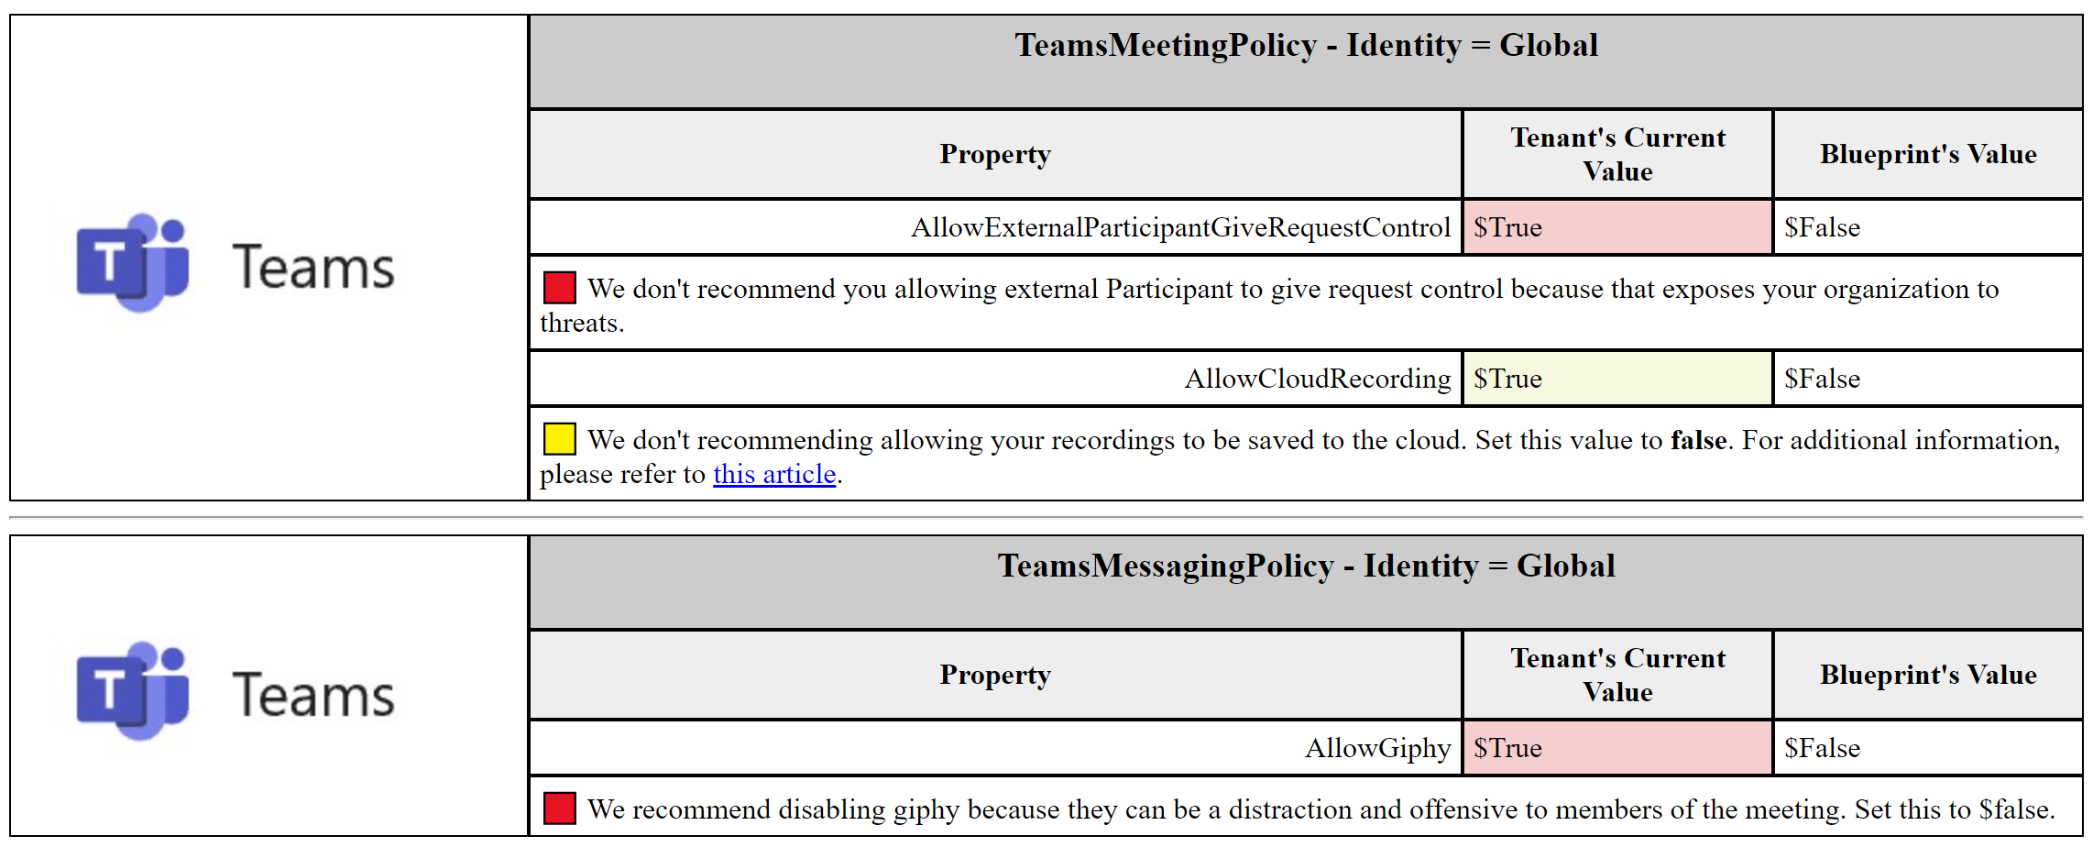

Slide 32

Assess – Different Tenants
Tenant A
Tenant B
Discrepancy Report
Export
Export
Generate
Compare
@NikCharlebois

Slide 33
Assess – Delta between 2 Point-in-Time Exports
April 2020
Export
April 2020
@NikCharlebois

Slide 34
Assess – Delta between 2 Point-in-Time Exports
May 2020
Export
April 2020
May 2020
@NikCharlebois

Slide 35
Assess – Delta between 2 Point-in-Time Exports
Discrepancy Report
Generate
April 2020
May 2020
Compare
@NikCharlebois

Slide 36
Demo 6
Assess
@NikCharlebois

